Slide 1


Android Lecture #3
Widget
TextView, ImageView
EditText, ClockWidget, Button

Slide 2


목차
TextView
ImageView
EditView
ClockWidget
Button

Slide 3
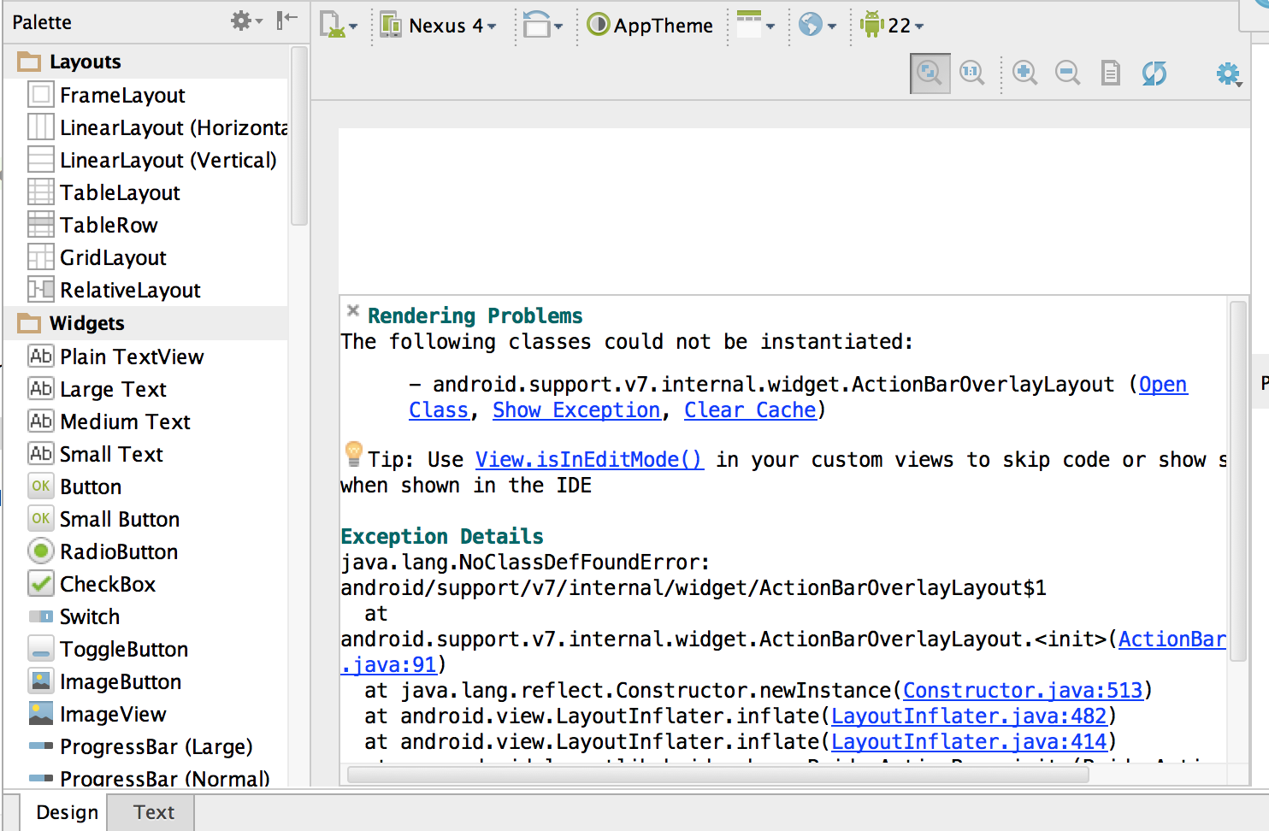
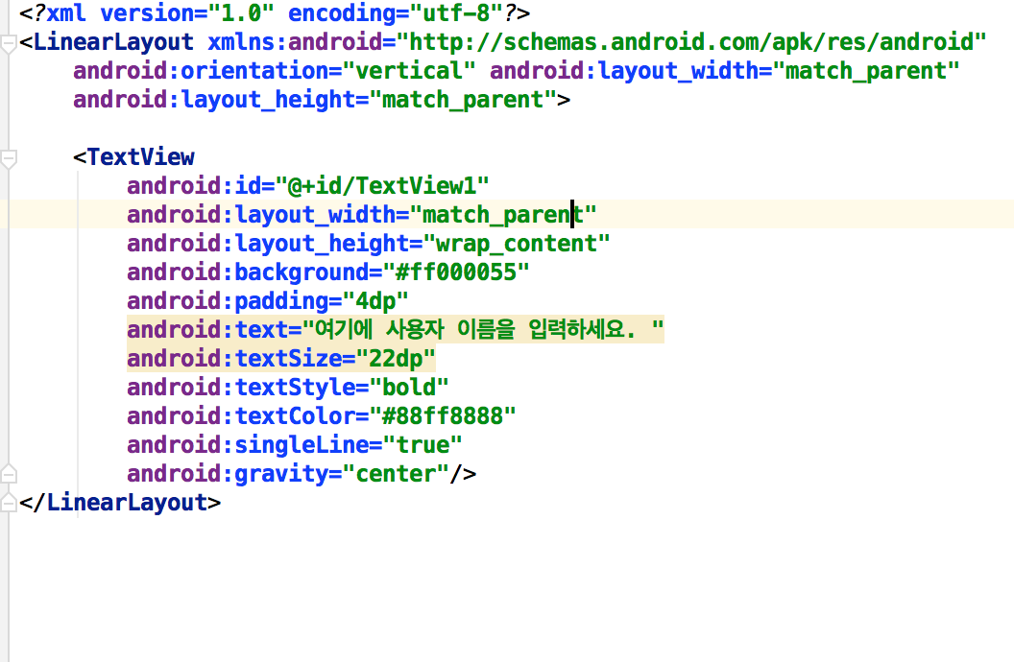
Making Widget
Design and Text

Slide 4
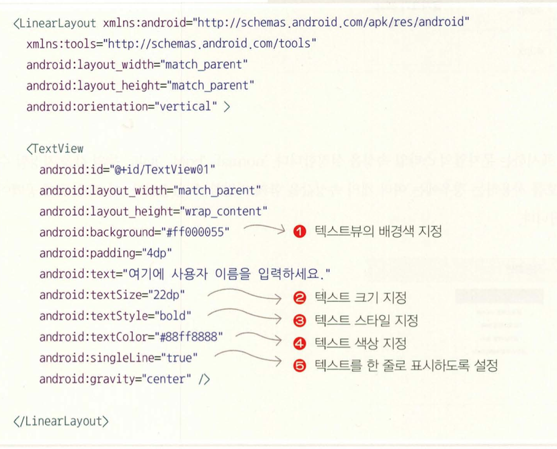
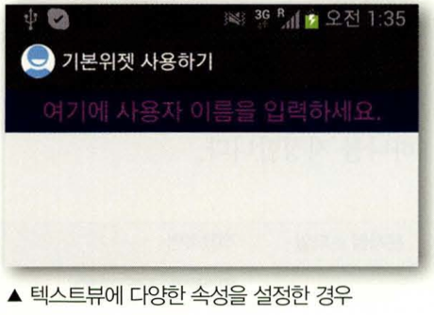
1. TextView
TextView

Slide 5
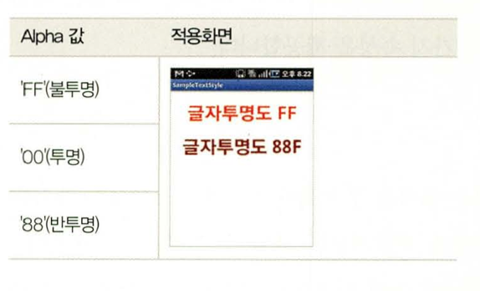
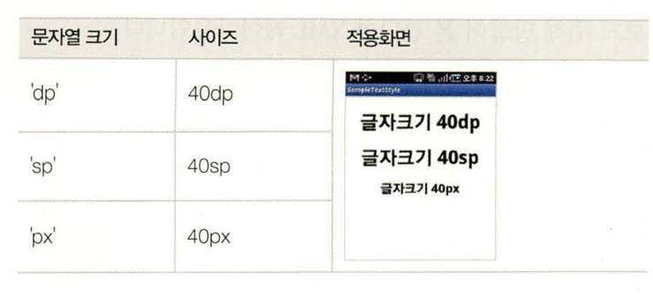
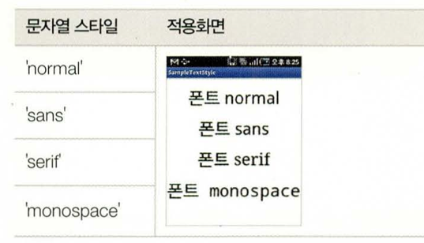
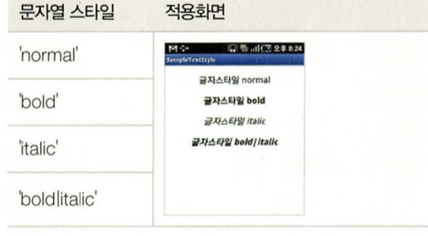
1. TextView
TextView Atribute
Background : Set TextView background color
textColor : textVIew 표시하는 문자열 색상 설정
textSize : textView 표시하는 문자열의 크기 설정
textColor : Set TextView textcolor
textSize : Set TextView textsize
singleLine: 문자열을 한 줄 또는 여러줄로 할지 성정
typeFace : textView 표시하는 문자열 폰 설정
TextStyle : textView 표시하는 문자열 스타일 설정
singleLine : Set TextView singleline
Font : Set TextView Font
textStyle : Set TextView textstyle

Slide 6
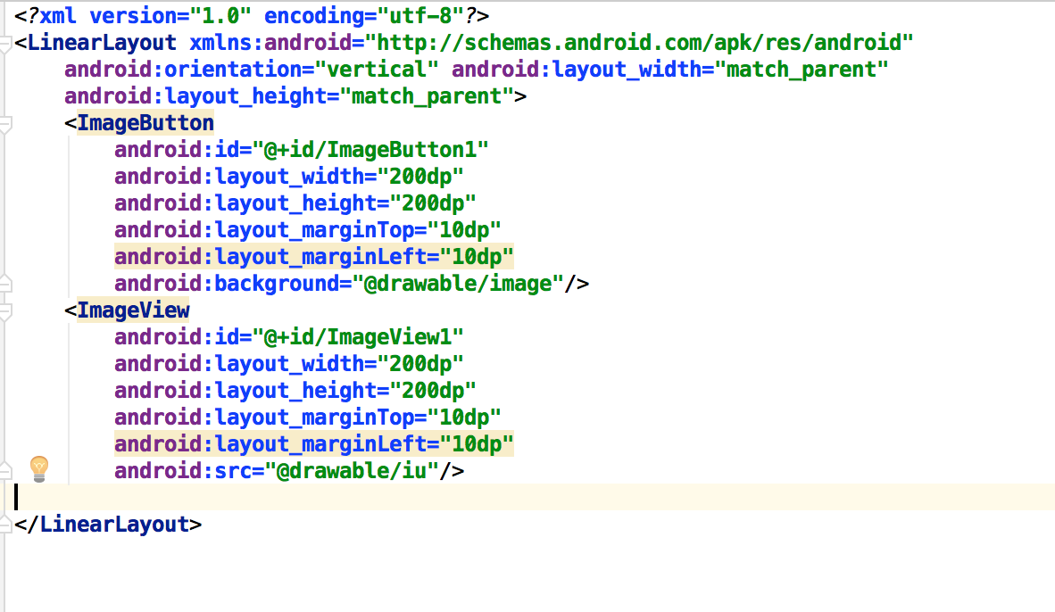
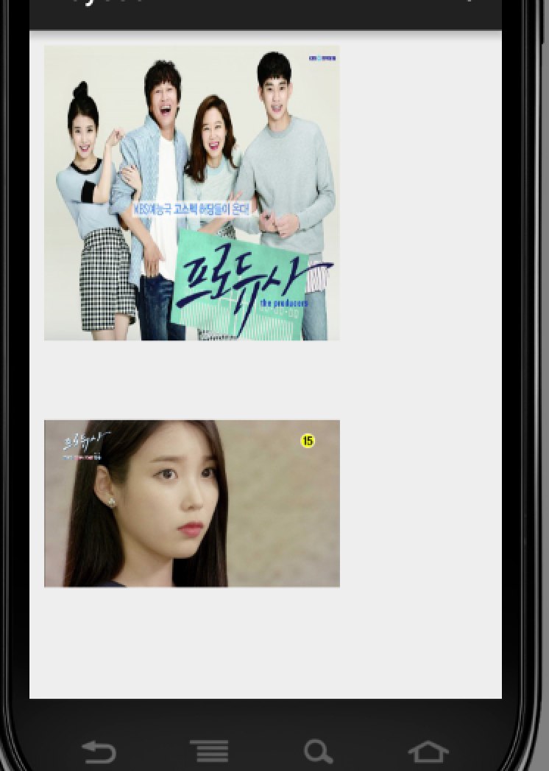
2. ImageView
ImageView

Slide 7
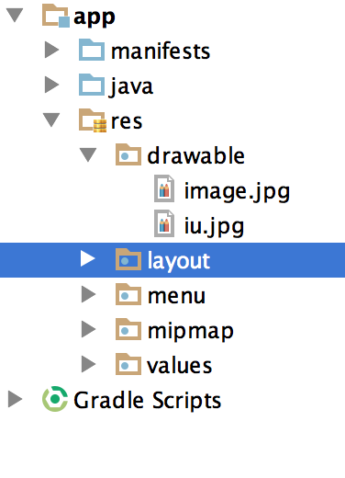
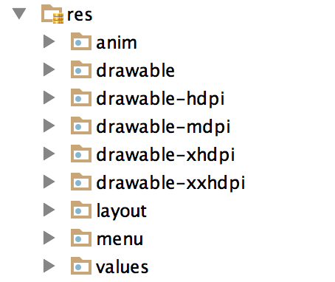
2. ImageView
ImageFile Input
Control + c -> drawable -> control + v
Image fixel

Slide 8
2. ImageView
ImageView 요소
src : location of image file
maxWidth, maxHeight : Define max size
tint : apply color on the image
scaleType : When image have difference original image and image that in code, it can make bigger and smaller

Slide 9
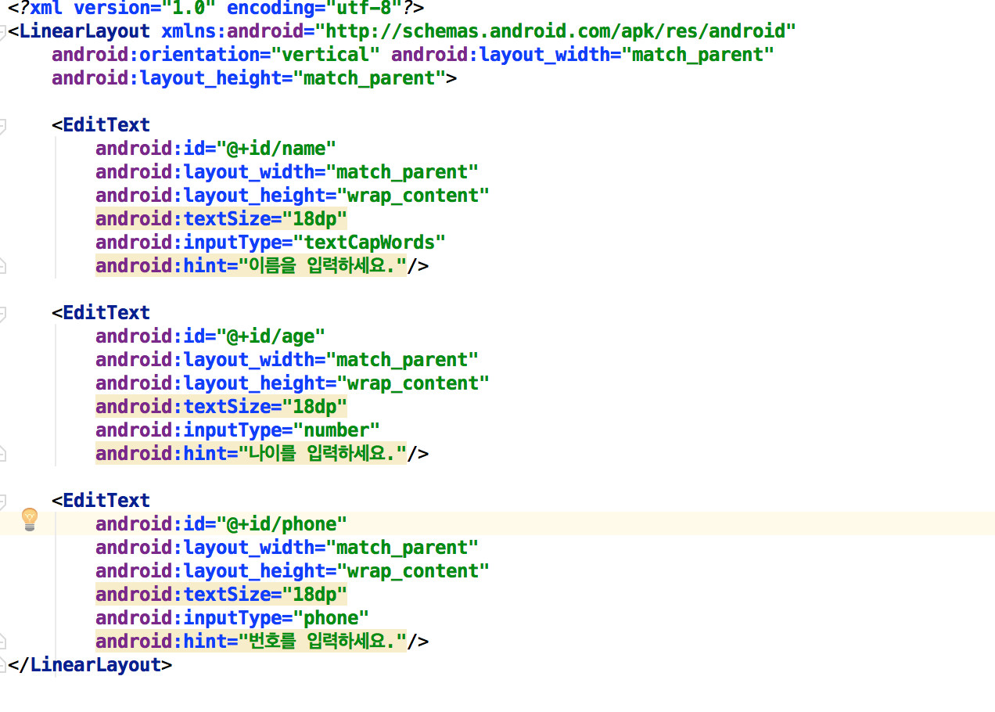
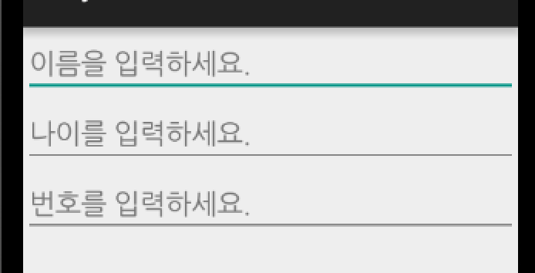
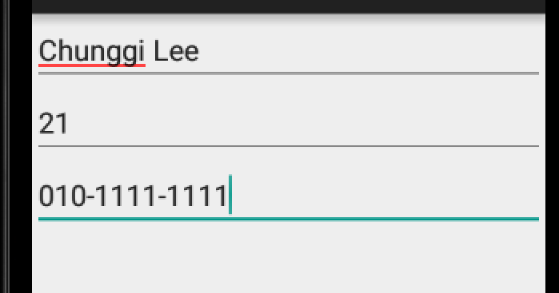
3. EditView
EditView

Slide 10
3. EditView
EditView Component
hint : Explain text
inputType : Can define input type
Number : can input number style
Date : can input date style
Phone : can input phone style

Slide 11
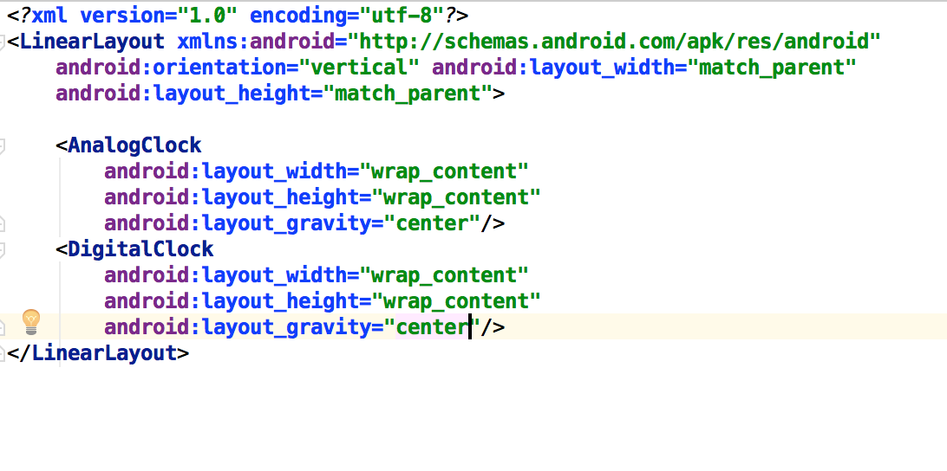
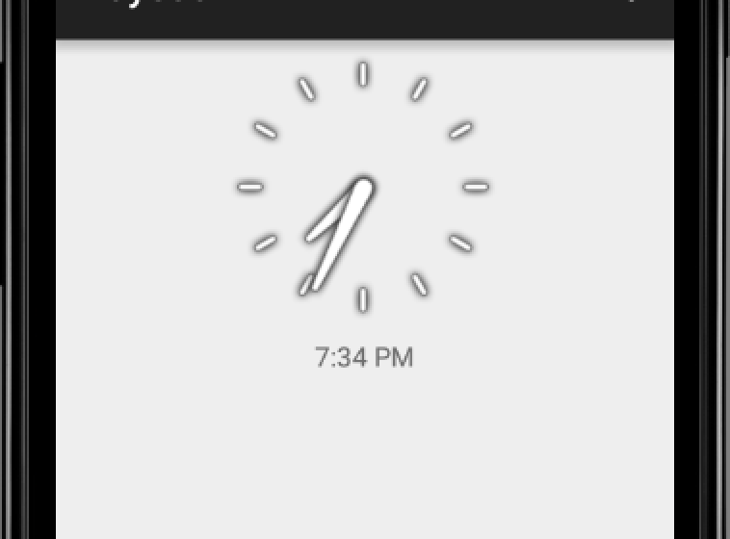
4. ClockWidget
ClockWidget

Slide 12
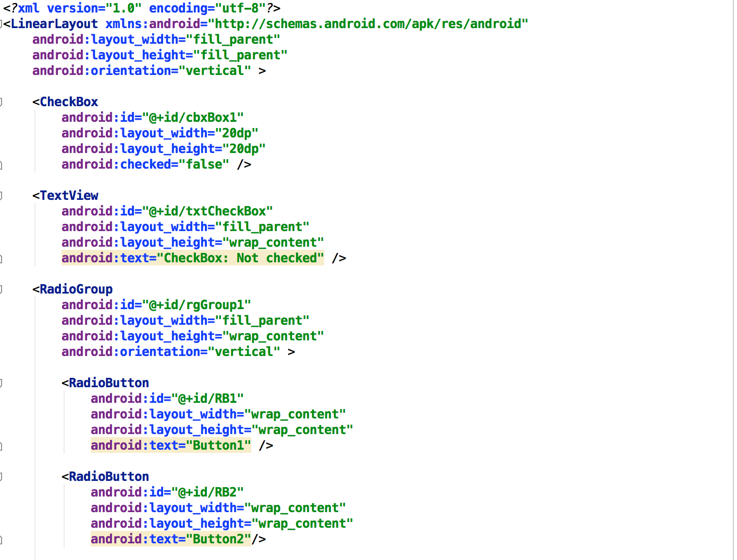
5. Button
Button

Slide 13
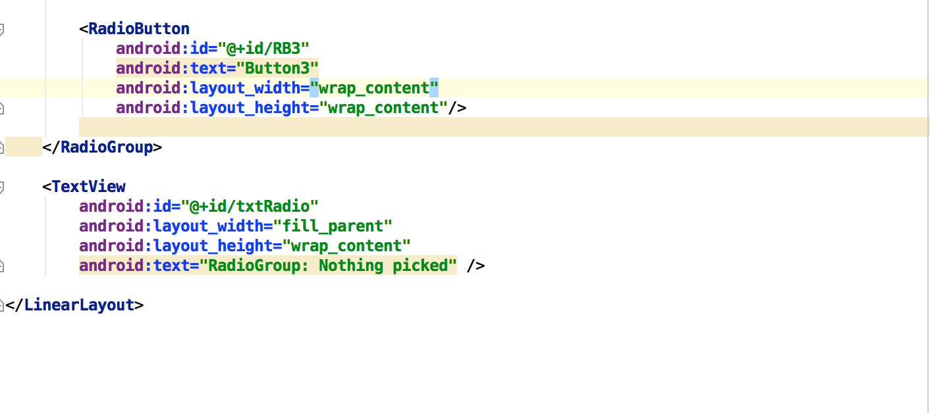
5. Button
Button

Slide 14
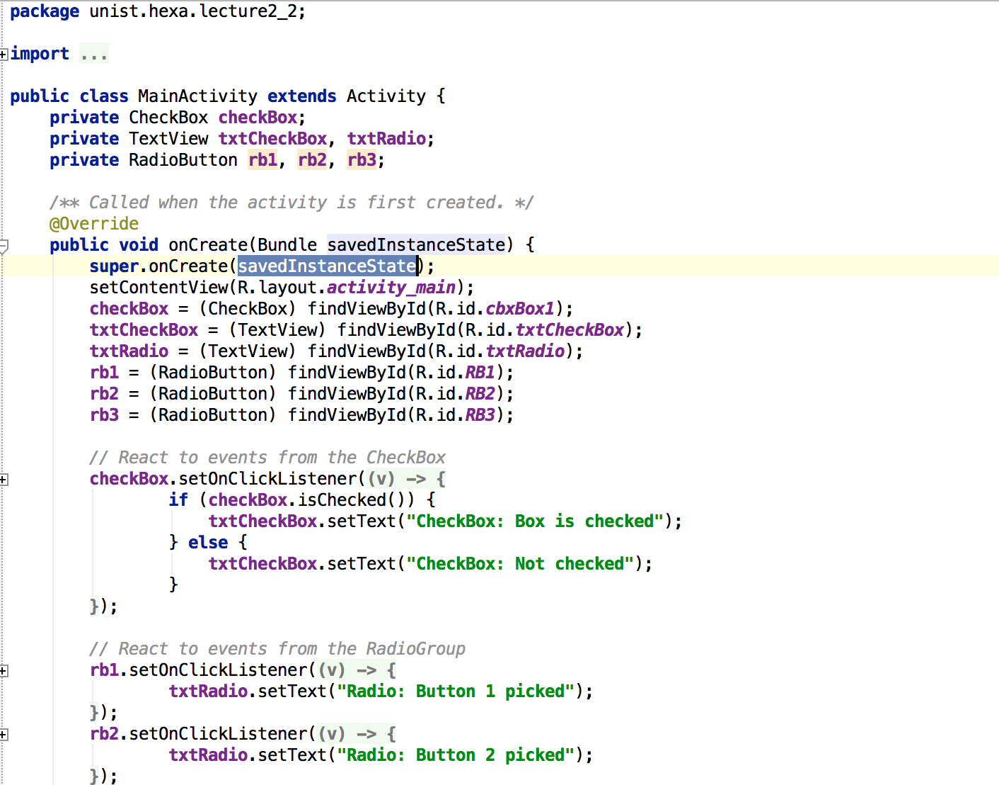
5. Button
Button

Slide 15
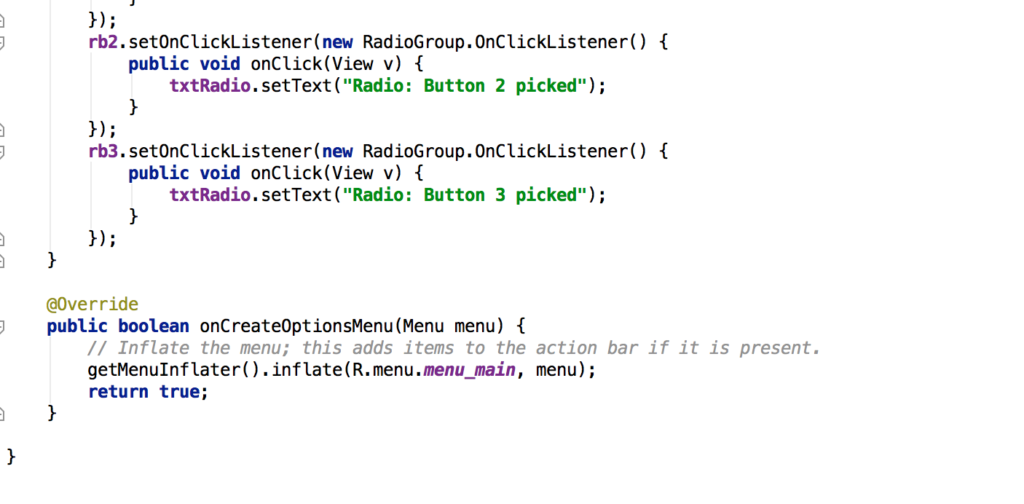
5. Button
Button

Slide 16
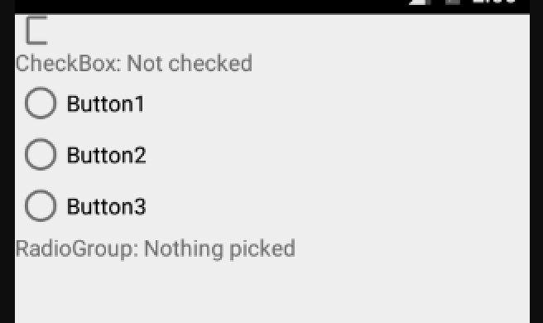
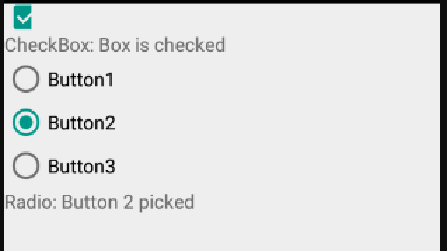
5. Button
Button

Slide 17
Thank you!

